Slide 1


DHANALAKSHMI SRINIVASAN ENGINEERING COLLEGE
(AUTONOMOUS)
PERAMBALUR – 621 212
Department of Artificial Intelligence and Data Science
Project Guide : Prof. R. Aarthy M.Tech., (Ph. D)
Project Team :
SUGANRAJ P (810421243056)
SUNDARAPANDIYAN T (810421243057)
SANTHOSH R (810421243305)

Slide 2
DIET NUTRITION ASSISTED SYSTEM BASED ON FOOD RECOGNITION USING DEEP LEARNING

Slide 3
INTRODUCTION
Now a day, people across the universe are becoming more sensitive to their diet.
Unbalanced diet can cause many problems like weight gain, obesity, sugar, etc. So different systems were developed so as to analyse food images to calculate calorie, nutrition level etc.
The standards imposed and automation carried out in food processing industry takes care of food quality.
Over the last few years, the food-as-medicine concept has gained momentum- thanks to physicians' and practitioners' awareness about making food an integral part of treatment for chronic illnesses along with their medications

Slide 4
ABSTRACT
Food is one of the most important requirements of every living being on earth.
The human beings require their food to be fresh, pure and of standard quality.
This system proposes a effective way to measure and manage daily food intake of patients and dietitians.
The system will take the images of food and using features extraction, segmentation and classification it calculates the nutrition and calorie content in the food.

Slide 5
EXISTING SYSTEM
Automatic food identification and calorie estimation become an important issue in last few years because of the negative impact of obesity in our health.
Obesity may cause cardiovascular diseases, diabetes mellitus type 2, obstructive sleep apnea, cancer, osteoarthritis, asthma, etc. Researchers said that junk foods and processed foods are responsible for increasing the childhood obesity.
A semi-automatic system was proposed which measure the caloric from the food intake.
System utilizes nutrition table for better results. Manual approach needed to prepare the diet chart for every food.

Slide 6
PROPOSED SYSTEM
A food nutrition and energy intake recognition system for medical purposes is proposed.
In addition to nutritional information tables, this system is based on food image processing, shape identification, and other technologies.
In this method, a measurement method that estimates the number of calories from a food’s image by extracting the volume of the food inside the image by using the thumb as a reference.
The application is designed to aid dieticians for the treatment of obese or overweight people, although normal people can also control more closely their daily eating without worrying about overeating and weight gain.

Slide 7
ADVANTAGES AND DISADVANTAGES
ADVANTAGES :
Time complexity is reduced.
Accurate measurement.
Automatic recognition of food.
Help the users to know the food information easily and assist the diet planner.
DISADVANTAGES:
Existing systems are not so accurate.
Time complexity in train the table.
Error can be occurred at the time train the details.
There is no approach to recognize food based on image processing techniques.

Slide 8
MODULES SPLIT-UP
Framework construction
Image Acquisition
Preprocessing
Features extraction
Classification

Slide 9
MODULES OF THE PROJECT
FRAMEWORK CONSTRUCTION
In Diet Assistance system user can identify whether the food is safe or not based on their BMI value.
This proposed framework calculating the diet recommendation for the user is based on the consumed food for that day.
In this framework user has register in the application to login and need to enter the height and weight parameters to calculate BMI.
Based on these inputs recommendation system gives nutrient diet suggestions and display the deficit nutrients to fulfill the nutrition food to the user to fill the nutrition for that day.

Slide 10
Image Acquisition
In this module, we can train and test the images for food calorie calculation.
First upload the images for training.
After that upload the image for testing to get the calorie information.
Food images may be any type or any size.

Slide 11
Preprocessing
In this module, implement gray scale conversion to convert the RGB image into gray values.
After implement noise filtering to eliminate the noise in uploaded images.
Median filtering can be used to eliminate the noise in images.

Slide 12
Feature Extraction
Image features are categorized into two types such as low level features and high level features.
Use the low level features to extract the food color, shape and texture values.
These features are used to train the food with name and add calorie details such as energy, fat and so on.

Slide 13
Classification
In this module implement machine learning approach to recognize food.
CNN algorithm can be used to classify features and labeled as food name.
After food recognition, automatically extract the information about calories.
And also recommend the food based on User BMI values.

Slide 14

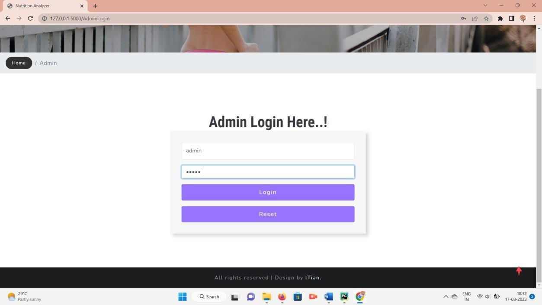

Slide 15
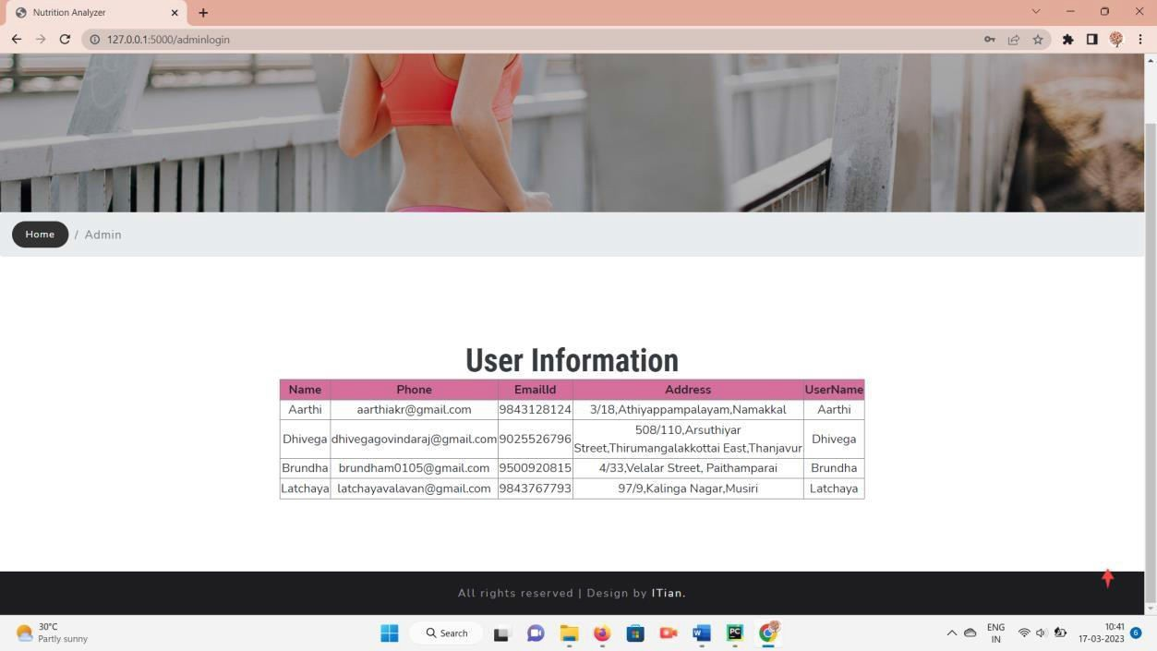
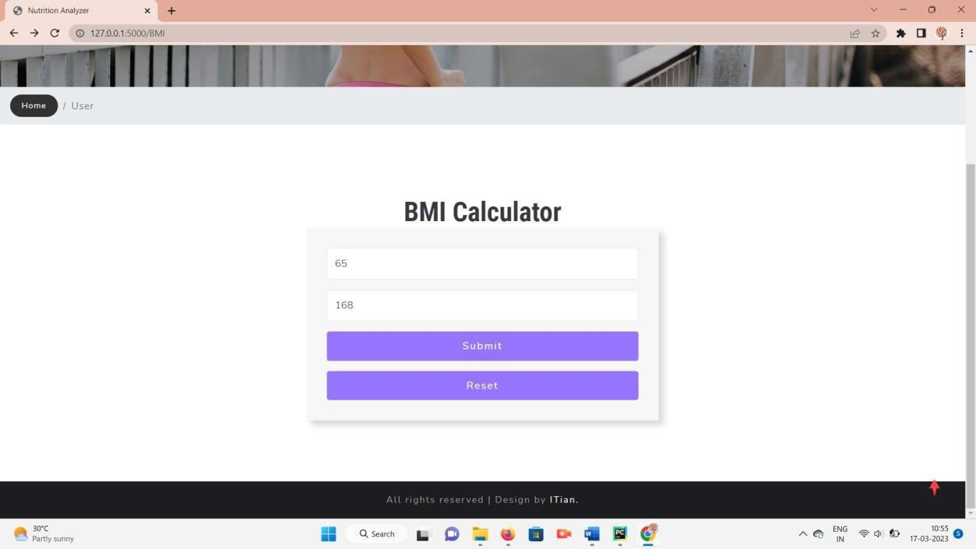

Slide 16
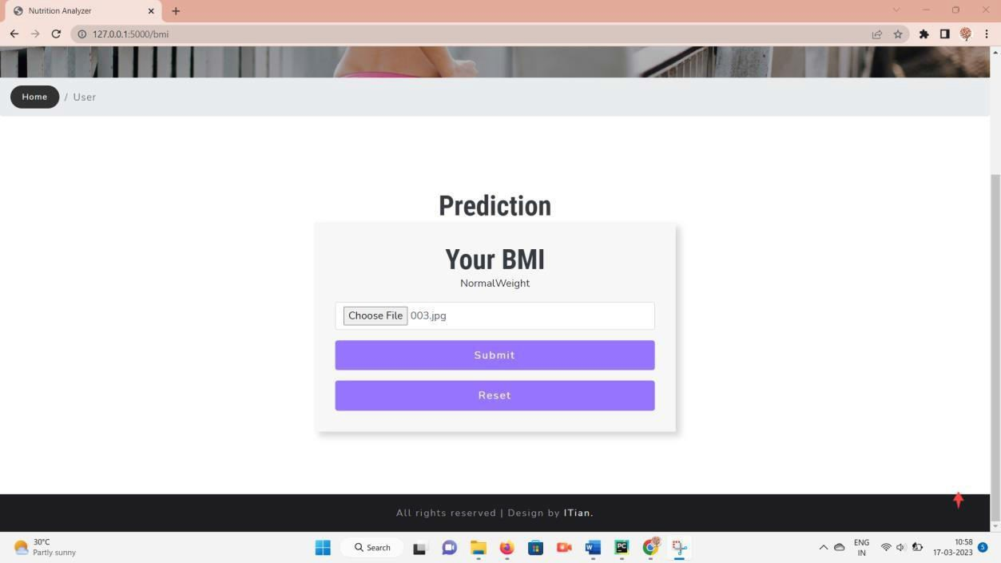
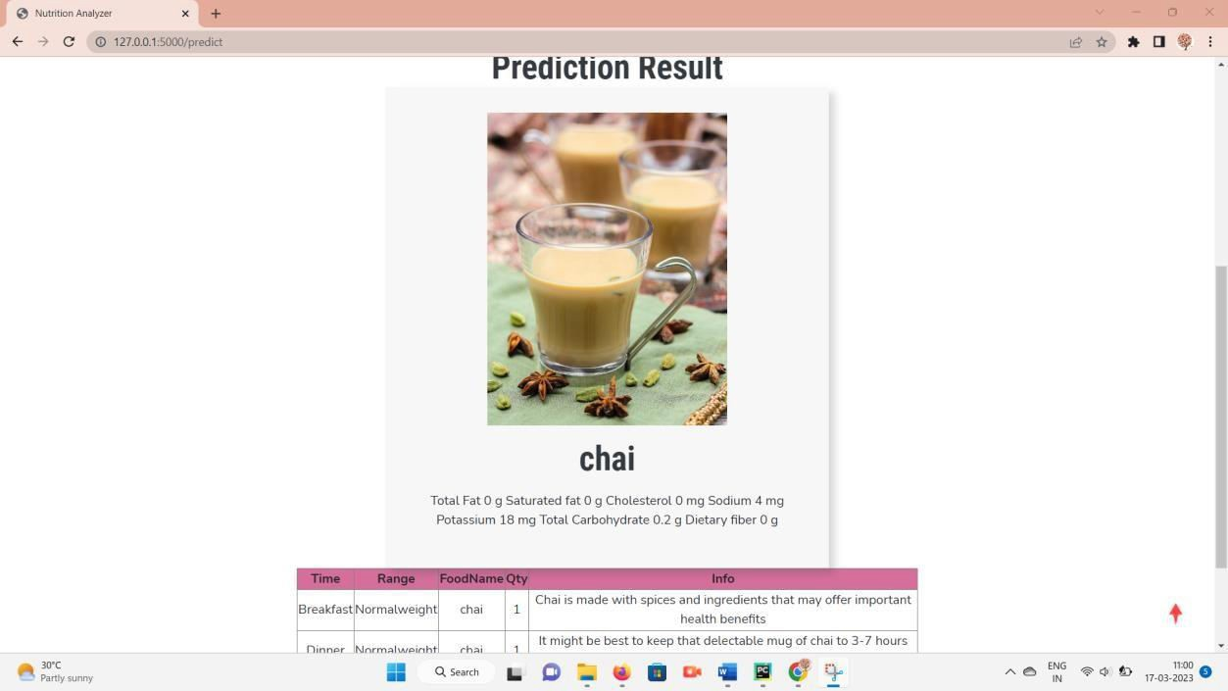

Slide 17
CONCLUSION
People are paying more attention to their health on a global scale. They are using a variety of techniques to stay in shape. One the way is to measure the calorie and nutrition level in the meal.
This project has given a brief review of different calorie and nutrition measurement system. After discussing various systems, it is found that there is scope for another system that can develop in order to help the patients and dieticians.
A system is proposed which uses segmentation and classification using Convolutional neural network to measure the calorie and nutrition level in the meal. System is cost effective and simple. Practical results of the system might boast the research in the field of food processing.
We proposed a measurement method that estimates the number of calories from a food’s image by measuring the area of the food portions from the image and using nutritional facts tables to measure the amount of calorie and nutrition in the food.

Slide 18
REFERENCES
Goh, Alex M., and Xiaoyu L. Yann. (2021) “Food-image Classification Using Neural Network Model.” Int. J. of Electronics Engineering and Applications, Vol.9, No.1, pp.12-22.
He, Jiangpeng, et al. (2020) “Multi-task image-based dietary assessment for food recognition and portion size estimation.” IEEE Conference on Multimedia Information Processing and Retrieval (MIPR) IEEE, Vol. 9, pp.1676.
Jiang, Landu, et al. (2020) “DeepFood : food image analysis and dietary assessment via deep model.” IEEE Access, Vol.8, pp.47477- 47489.
Lo, Frank Po Wen, et al. (2020) “Image-based food classification andvolume estimation for dietary assessment: A review.” IEEE Journal of Biomedical and Health Informatics, Vol. 24.7, pp. 1926-1939.

Slide 19
Thank you

